Slide 1

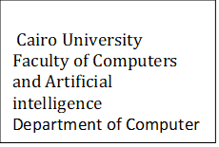
Gene mutation on covid Supervised by Dr. Amin Allam Dr. Ahmed Farouk TA. HODA Ahmed
Implemented by :
Graduation Project
Academic Year 2021-2022
Midyear Presentation
Student id | Student name
20188008 | Andrew Medhat Kamal
20188037 | Omar Ahmed Sayed
20188053 | Nada yassen Abdirahman
20188025 | Sara Mostafa Ahmed
20188039 | Lina Bassel Mohmed

Slide 2
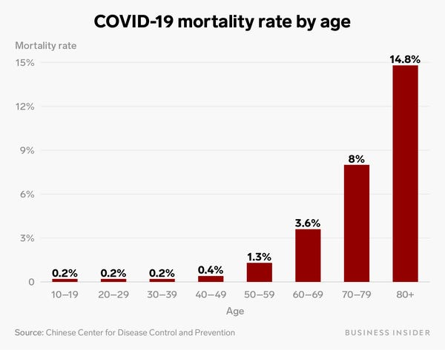
Project idea
Our Idea :
Get several new variants of Covid-19
Predict whether mutation bind with human cell or not
Domain of interest is machine learning with Bioinformatics

Slide 3
Problem significance
What is the problem you are going to solve ?
We are going to get mutation of covid
without experiments in laboratories.
Why ?
to be ready in Our real world if covid Mutated (as omicron)
and Scientist recommend drugs for this new mutation
How ?
By machine learning : using Recurrent Neural Network (RNN model).
Save Time
Save cost

Slide 4
What are the previous solutions to the problem ?
Scientists used genomic sequencing in laboratories to discover new variants.
Genomic Sequencing:
Taking the patient sample from the PCR test
Then compare the sequence to others in international databases.

Slide 5
Advantages:
Identify Viruses , understand their origin and transmission.
Help in designing candidate vaccines.
Help in developing new strategies to prevent spreading.

Slide 6
Disadvantage:
High cost , work and some techniques are too time consuming.
Possible harm for participants.
Participants may have little experience in sequencing of viral genome.
Require many human resources.
Probability of staff sickness and unavailability.

Slide 7
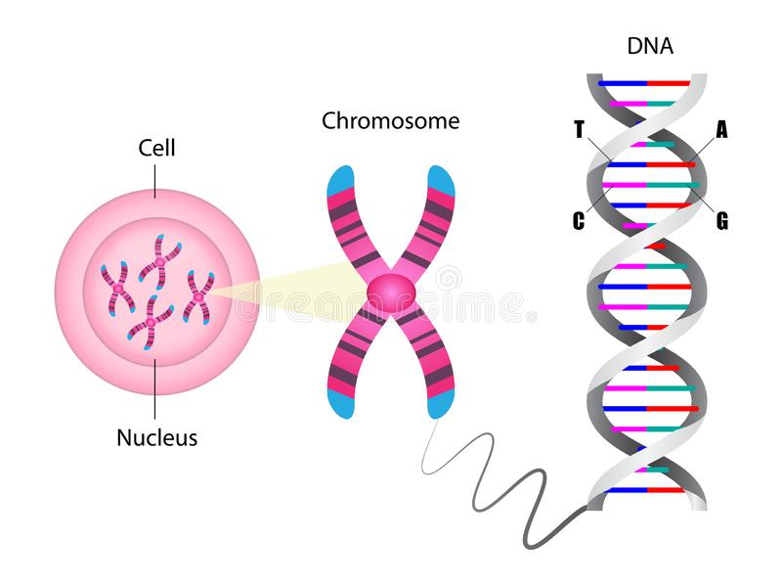
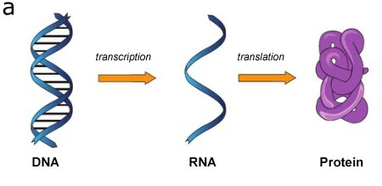
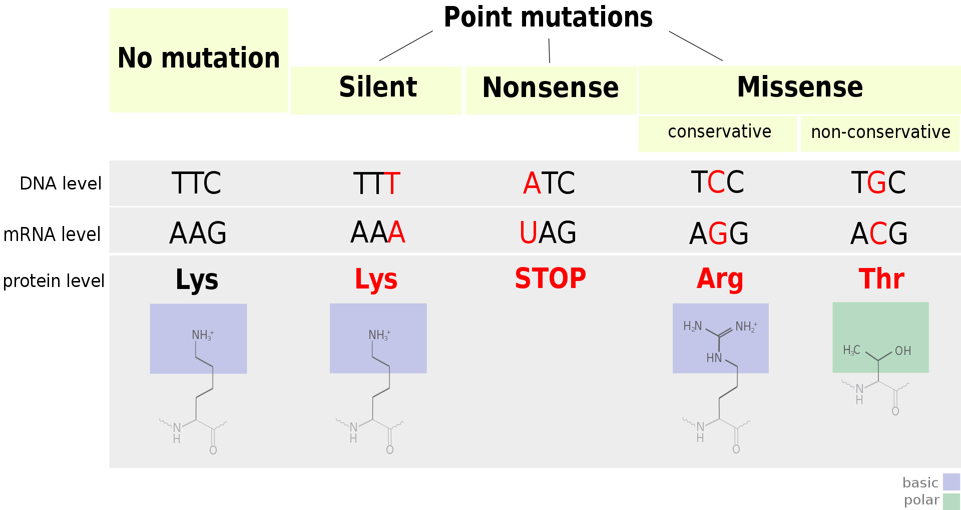
Biological Background
DNA & protein
Mutation ??

Slide 8
How will we mutate sequence ??
First Method:
by code we will change randomly in DNA / protein
Second Method :
Will get Ready mutated data and add it to our data
And we already find that on omicron
Will be our test data

Slide 9
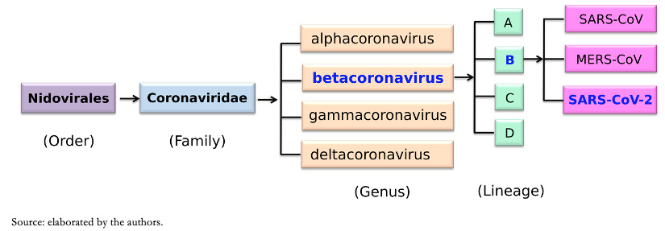
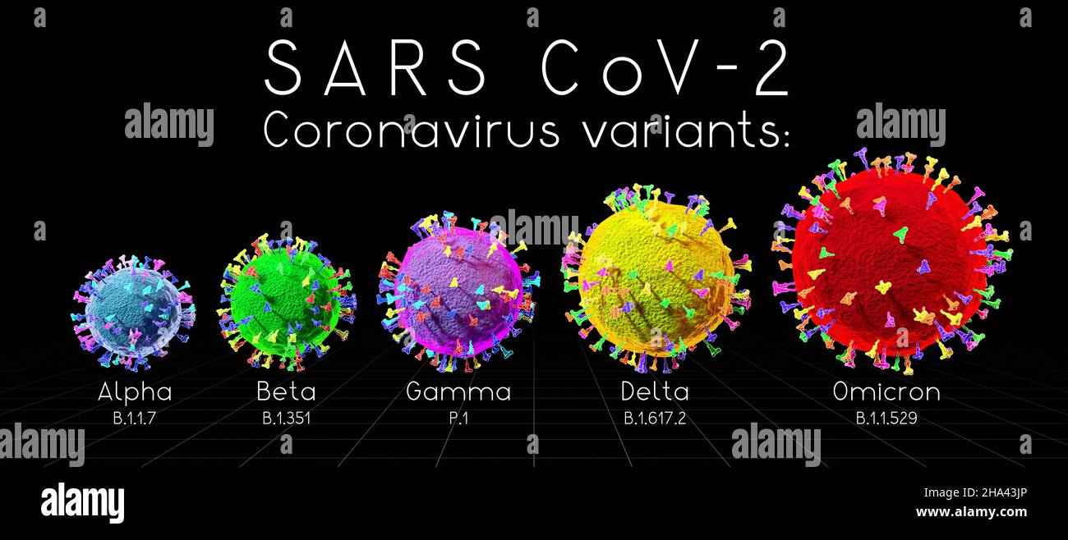
Project specification
Classification of coronavirus
→ we get four variants of coronavirus from NCBI
step1

Slide 10
What we need from the Genome??
We need conserved region (covid sequence)
We need structural proteins
We need binding part to human cell
Put them on excel sheet
in form of positive and negative region
Binding part
step2
Structural proteins
Covid sequence

Slide 11
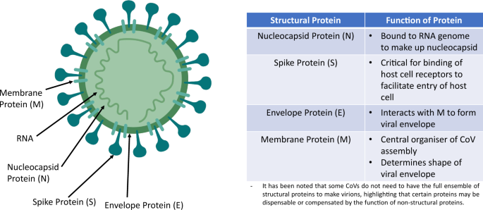
We studied the genome of coronavirus
Coronavirus genome has 4 major proteins
We are interested in the spike (S) protein

Slide 12
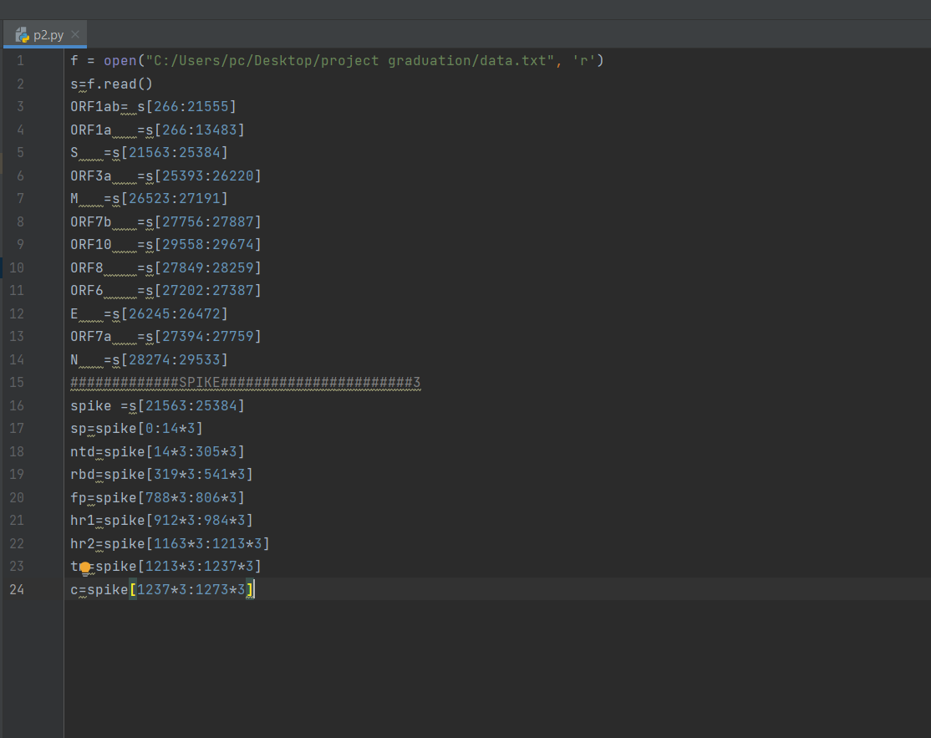
How we made step 2???

Slide 13
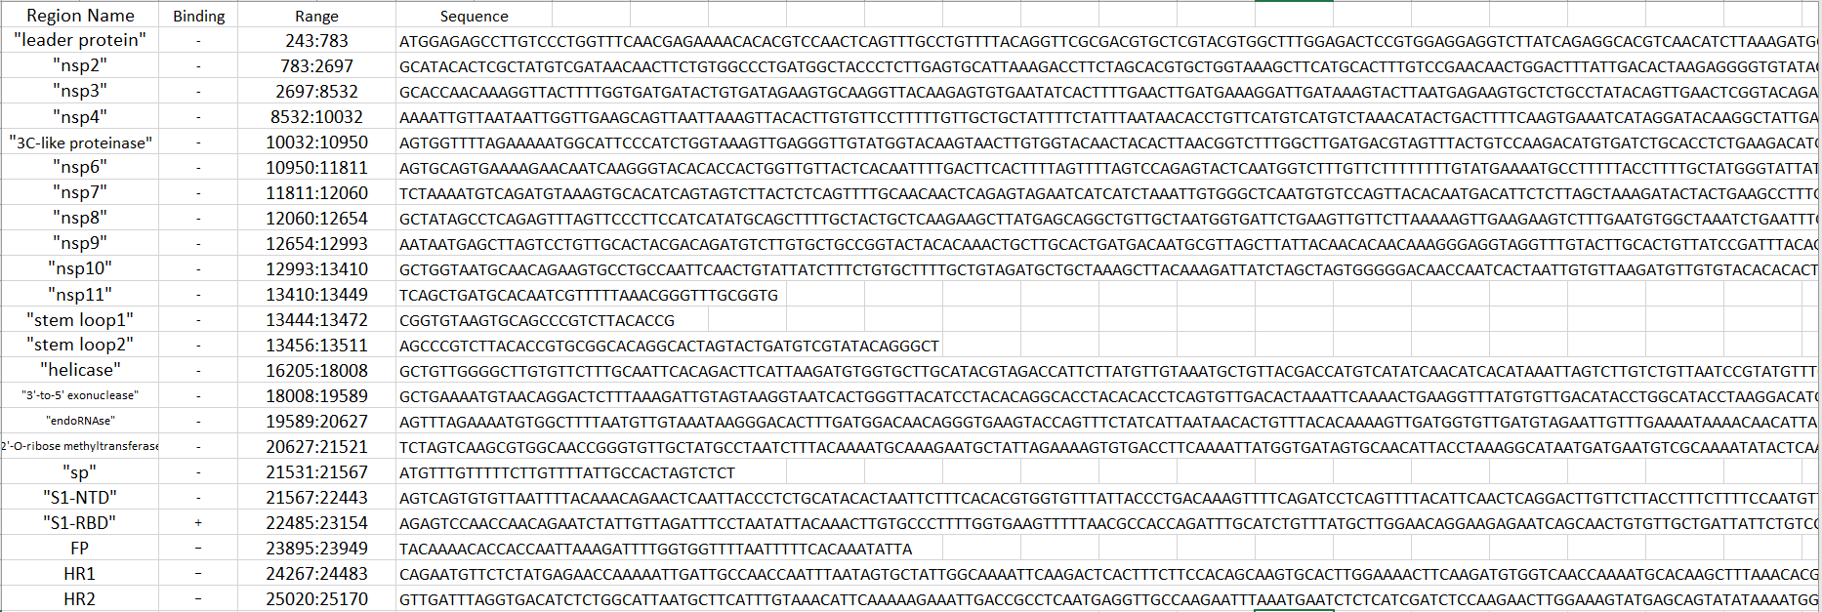
What is the result of step 2 ?

Slide 14
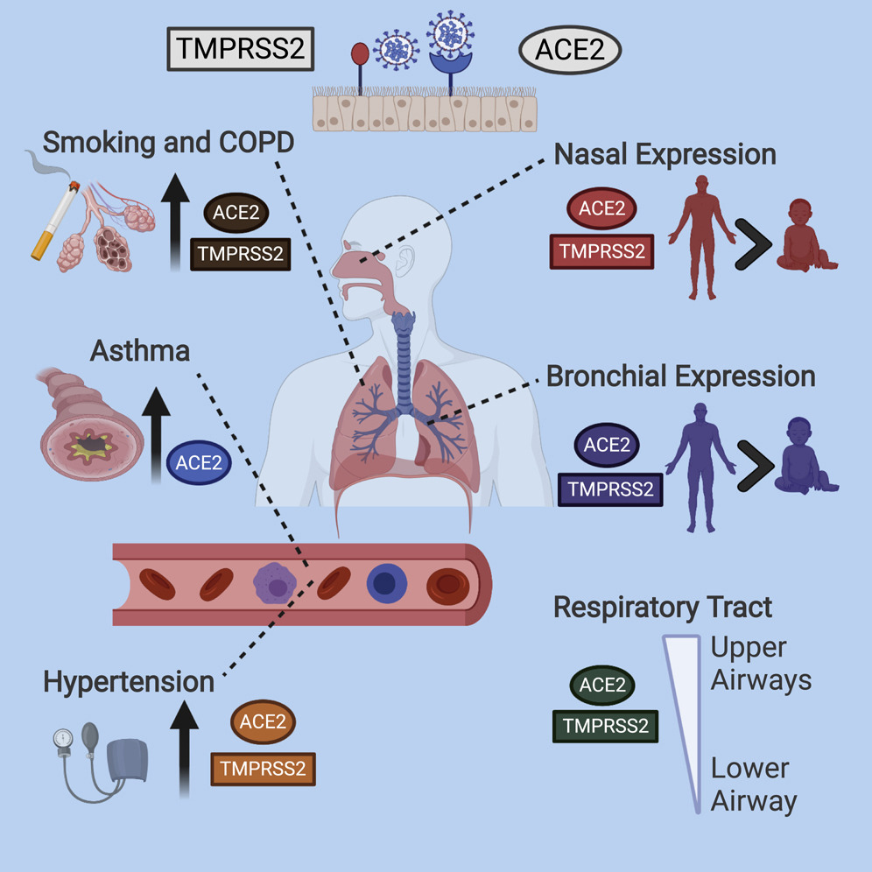
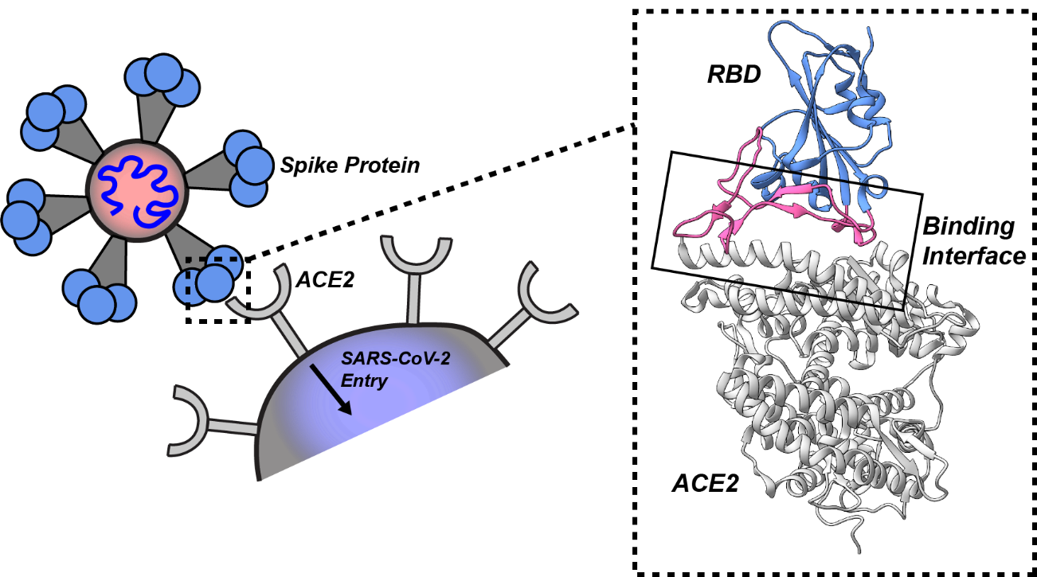
How infection occurs ??
Where covid bind in human cell ??
What help covid to enter through nose ??
What made covid go to lung ??
Answer is : ACE2 receptor in human cell
so we need get ACE2 receptor

Slide 15
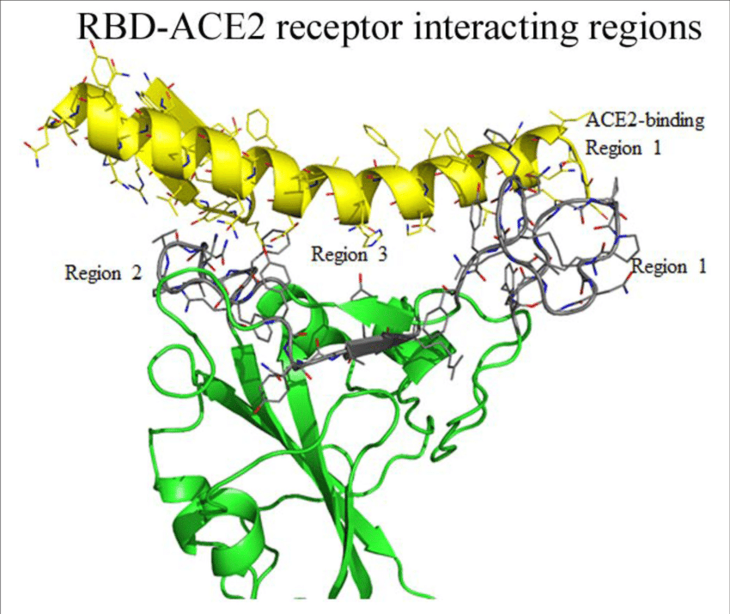
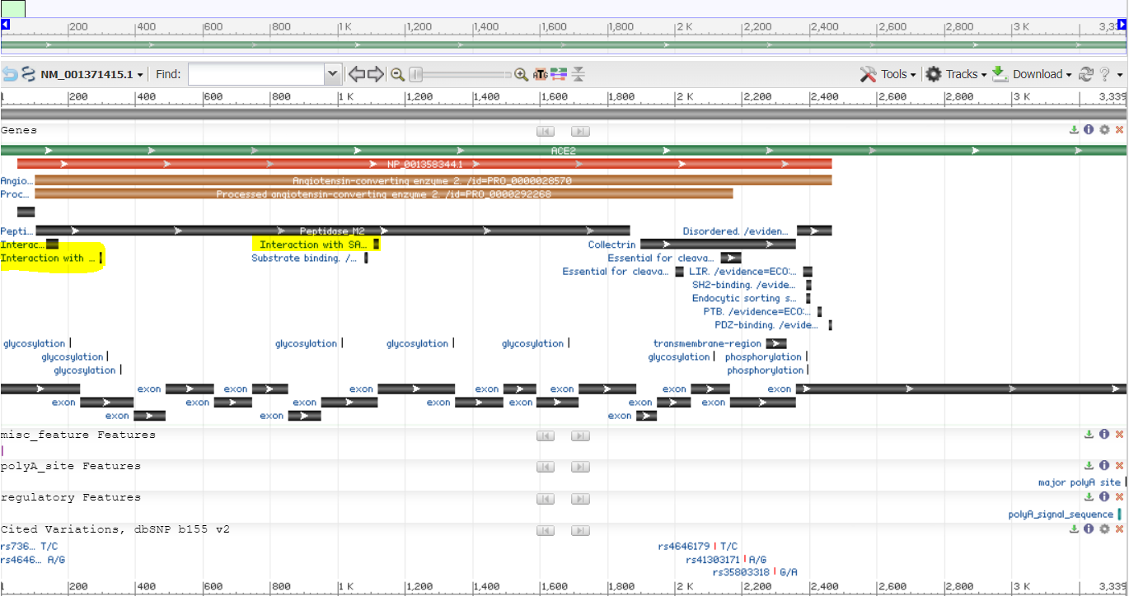
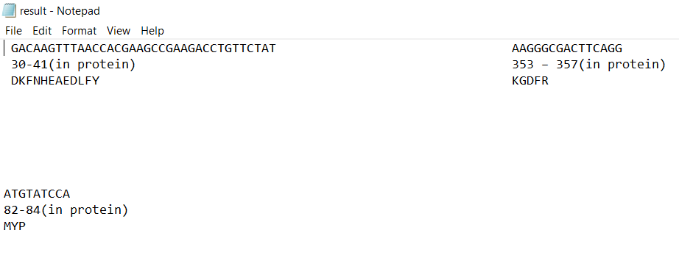
Which part in ACE2 bind with RBD ?

Slide 16
Why we get ACE2 receptor?
When produce our Mutated sequence for test data
To know whether the mutated sequence will bind to human cell or not
Compare result of docking tool and our project
Mutated Sequence
+
ACE2 Receptor
Protein Docking Tool
Input
To ensure

Slide 17

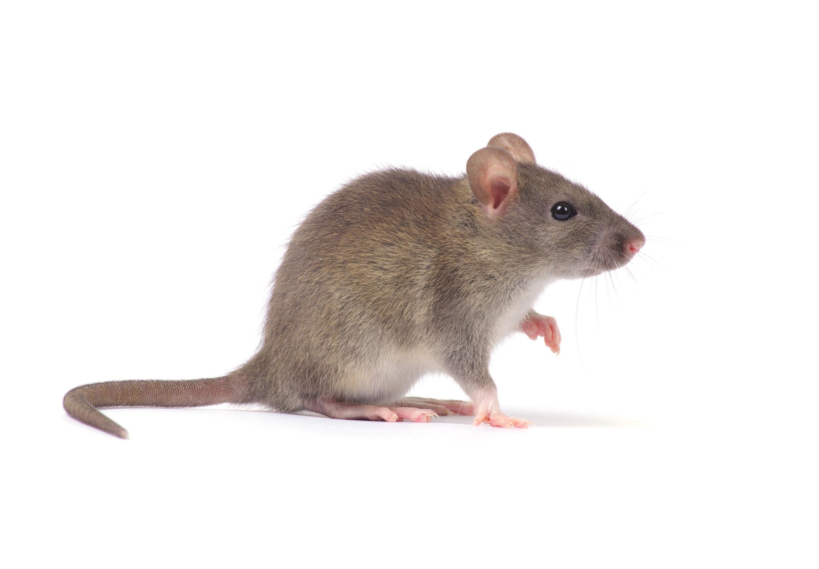
What we get until know ?
Four DNA sequence of covid corona
Alpha , Beta , Gamma , Delta
Excel sheet contain sequence
in form of positive and negative region
ACE2 for mouse and human
(their specific binding parts)

Slide 18
What is next ??
What we need to do after reaching this data ??
We need to take this excel sheet as Training data
that’s our input data
Build RNN model & train it on the training data
Model will be ready to enter new sequence (Our test data)
To be classified as positive and negative
that’s our output

Slide 19
Where we will stop??
This sequence is mutated one
we will see if it bind to ACE2 or not …… HERE we Stop
So we help researchers to recommend the suitable drug
New mutated sequence
Learned RNN model
Suitable drug

Slide 20
Why to use RNN model ??
RNN model is the most suitable model for our project.
Has internal memory
remember important things about the input they received
As it takes a sequence as input
classify it as negative or positive

Slide 21
To increase our training dataset:
Split the RBD of each variant into segments.
Also change randomly in these segments.(Mutated sequence)
To know whether the mutated sequence will bind to human cell or not
Mutated Sequence
+
ACE2 Receptor
Protein Docking Tool
Input

Slide 22
Time Plan
previous 4 months
Only RBD bind with receptor using help from NTD(human)
Four DNA sequence of covid corona
Alpha , Beta , Gamma , Delta ,Omicron
Excel sheet contain sequence
in form of positive and negative region
ACE2 for mouse and human
(their specific binding parts)
Specified that RNN model is the most suitable model.

Slide 23
Time Plan
next 4 Months:
Split RBD for each sequence.
Make our RNN model
Produce possible mutations
Enter them to Our learning model
The model should predict whether it will bind to human cell or not

Slide 24
Conclusion
Our project should help researches in :
1-Knowing the sequence of variants that may appear in the future.
2-Determining whether the current vaccines are efficient for these variants.
3-If not, Rapidly develop new vaccine for these variants

Slide 25
Thank you …
Any Questions??

